Slide 1
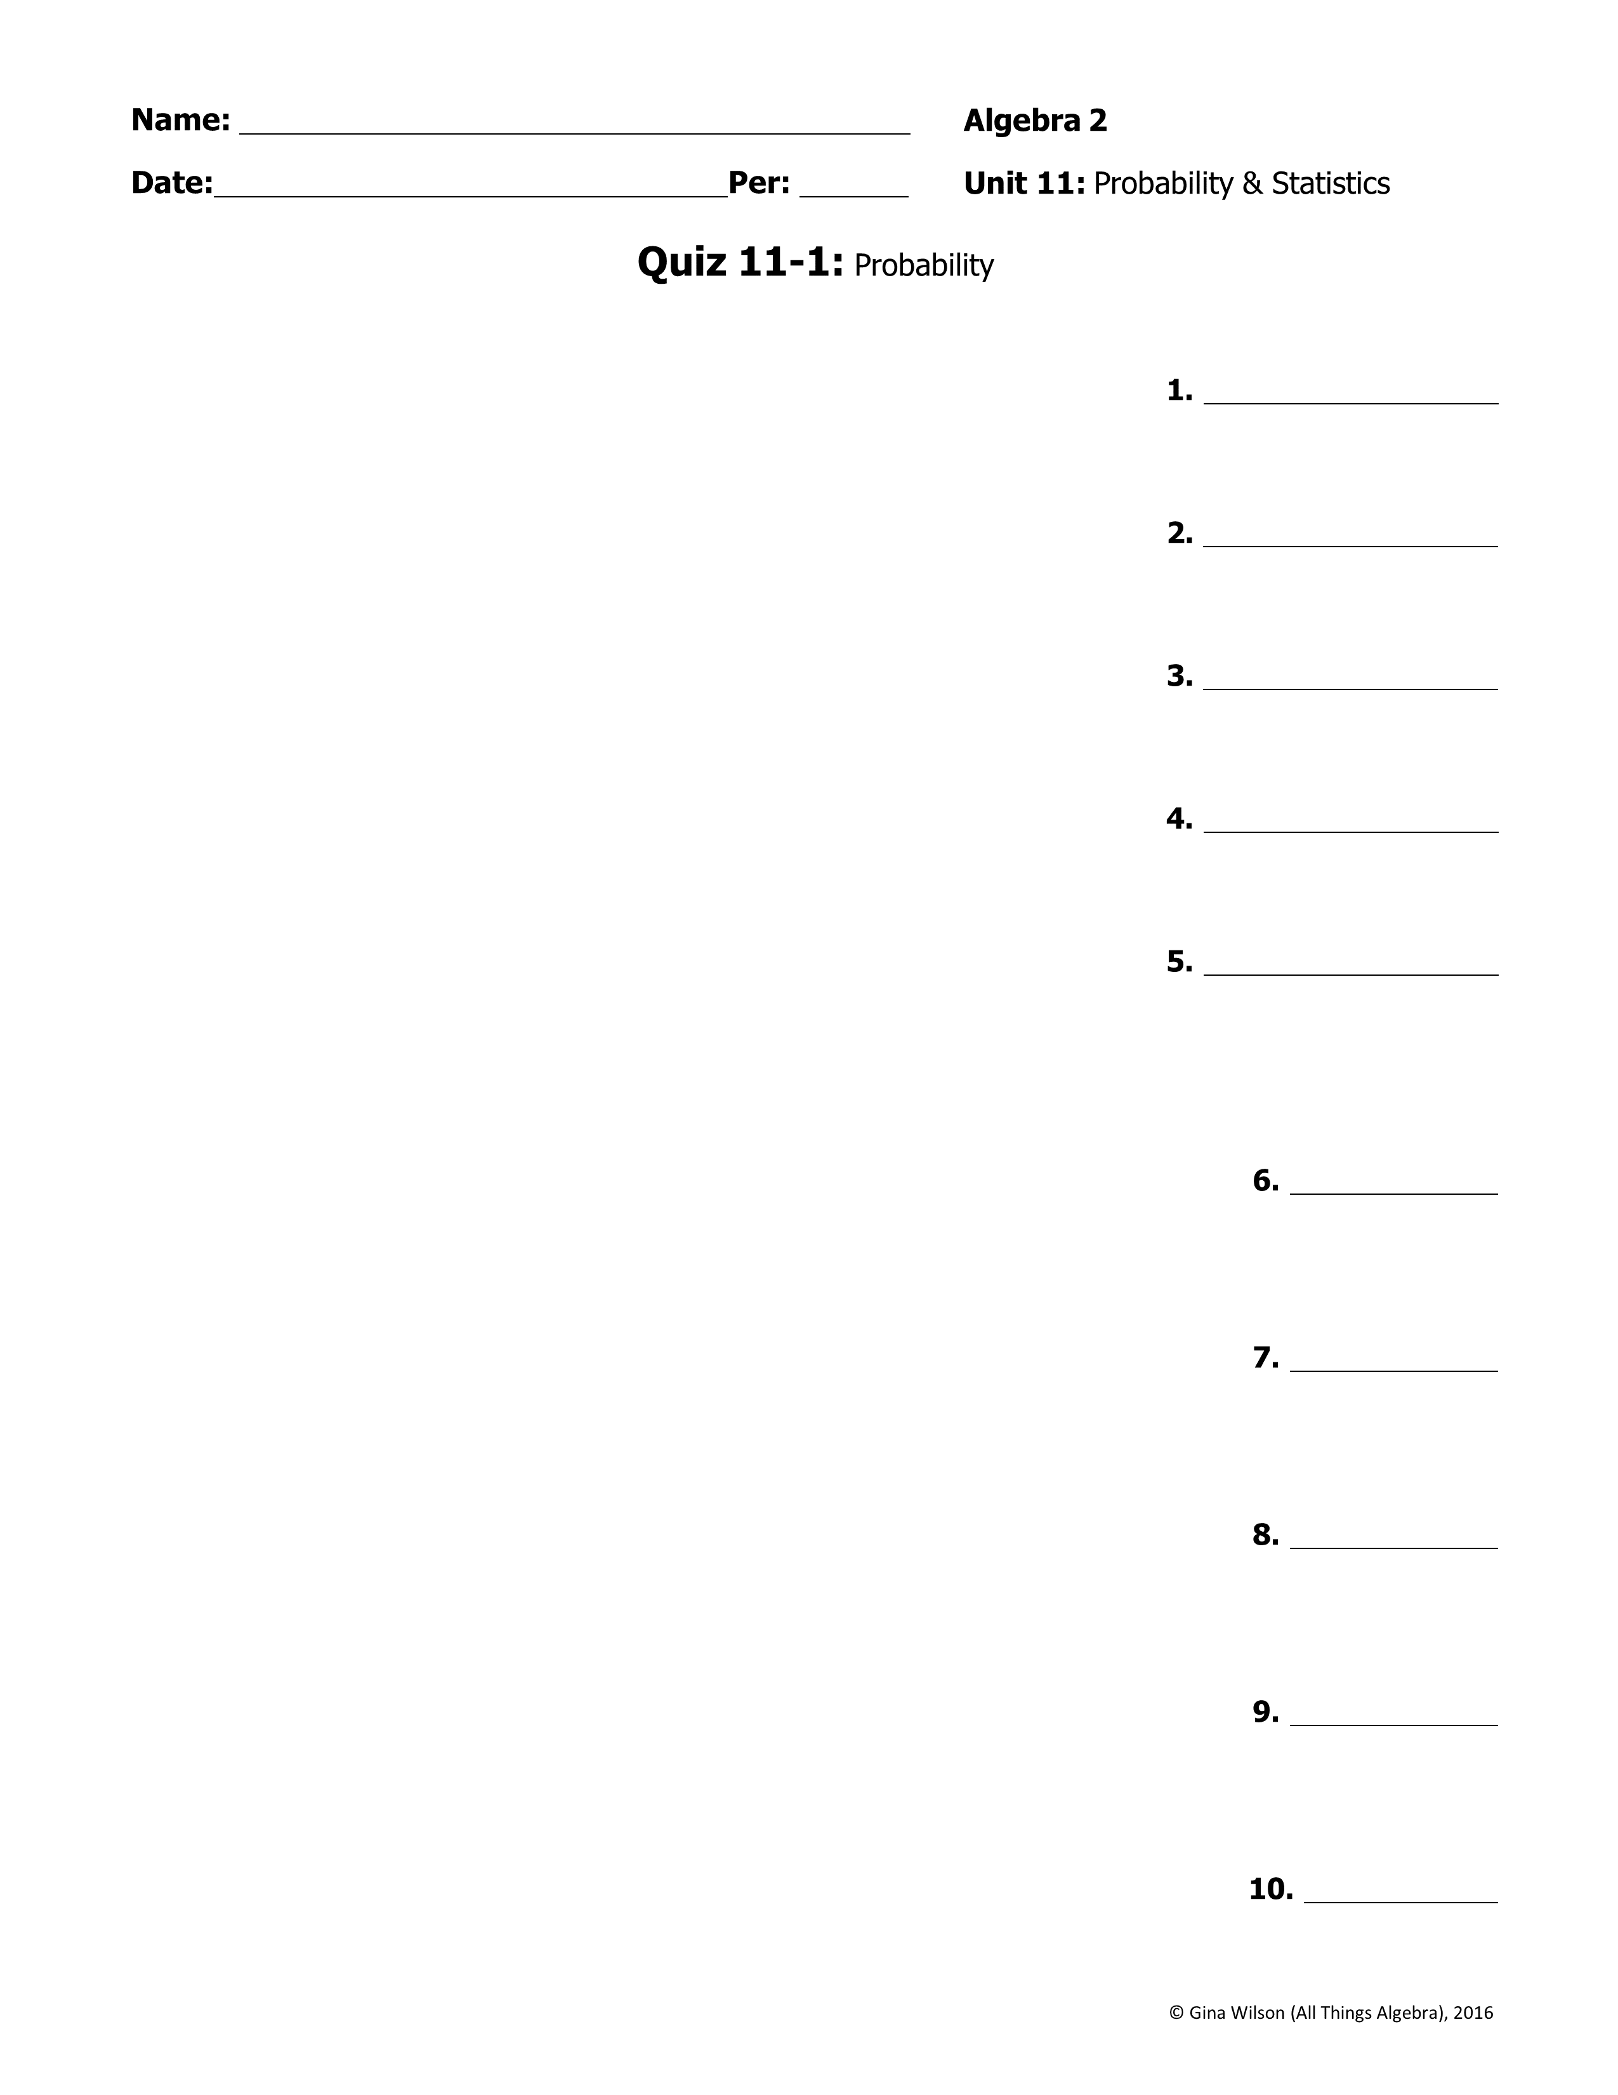
Part I – Counting Principle, Permutations, and Combinations
1. A six-sided number cube is rolled and a card is drawn from a standard deck. Find the total number of outcomes.
2. A science quiz has eight multiple choice questions with five choices for each. Find the total number of ways to answer the questions.
3. The golf club can send a team of four students to the next golf tournament. If there are 15 students in the club, how many different teams of four can be selected?
4. There are 18 skaters competing in the competition. How many ways can they win the gold, silver, and bronze medal?
5. What is the total number of different 10-letter arrangements that can be formed using the letters in the word SUSPICIOUS?
Part II – Probability: Give each answer as fraction in simplest form.
6. What is the probability of drawing a jack or a red card from a standard deck of playing cards?
7. A bag contains 40 slips of paper numbered 1-40. If one is randomly chosen, what is the probability of not choosing a multiple of 3?
8. A coin is tossed two times, then a month of the year is randomly selected. What is the probability of getting tails each time, and a month that starts with the letter J?
9. A bookshelf contains 9 mysteries, 7 biographies, and 4 science fiction books. A book is randomly selected, not replaced, then another is selected. Find the probability of selecting a biography then a mystery.
10. A shape is randomly selected from the following quadrilaterals: parallelogram, rhombus, rectangle, square, and trapezoid. What is the probability that it has four right angles, given that it has four congruent sides?

Slide 2

11. Of the 100 students enrolled at the dance studio, 50 take ballet and 24 take tap dancing. Eight of the students who take ballet also take tap dancing. If
a student at the studio is chosen at random, find the probability that they take ballet, if it is known that they do not take tap dancing.
12. The table below represents the number of NFL teams that won or lost their first game of the season. Find the joint relative and marginal relative frequencies.
 | Conference
 | AFC | NFC | Total
Won
Lost
Total
 | Conference
 | AFC | NFC
Won | 10 | 6
Lost | 6 | 10
Use the tables above to find each probability.
13. P(either AFC or NFC won)
14. P(NFC | won)
15. P(lost | AFC)
Part III – Binomial Probability: Give each answer as percent rounded to the nearest hundredth.
16. A coin is tossed 12 times. What is the probability of getting heads exactly 7 times?
17. Northern Airlines has a reputation for being on time 86% of the time. Find the probability that a Northern Airlines plane will be on time for at least four of its next five flights.
18. Scott strikes out at bat 36% of the time. Find the probability that he strikes out no more than three times on his next eight times at bat.

